Slide 1

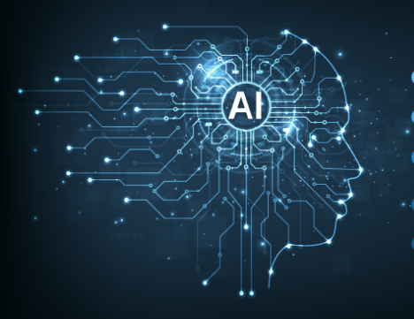
Generative AI
Full Stack Developer

Slide 2
Course D : Agentic AI

Slide 3
03
LangGraph Design Patterns
From Static Chatbots to Autonomous AI Systems

Slide 4

Agenda
LangGraph Design patterns
Pattern 1: Tool Use
Pattern 2: Reflection
Pattern 3: Planning
Pattern 4: Multi-Agent

Slide 5

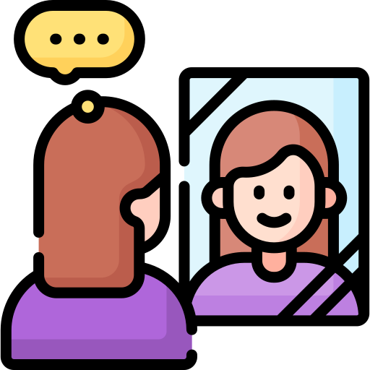
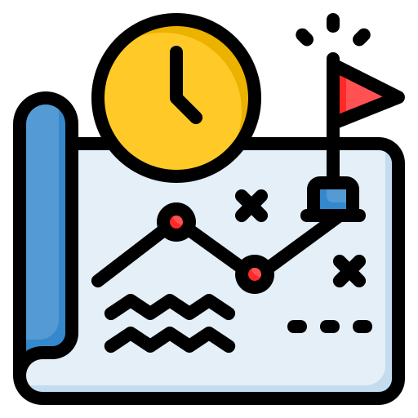
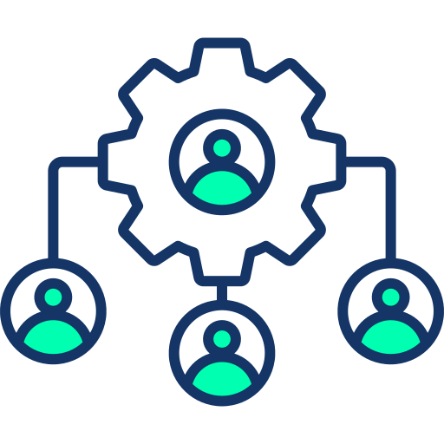
LangGraph Design patterns
Building on our knowledge of State, Nodes, and Edges, we will now explore common, reusable "recipes" for building
We will cover:
Tool Use Pattern
Reflection Pattern
Planning Pattern
Multi-Agent Pattern

Slide 6
Pattern 1: Tool Use
Goal: Equip agents to use external functions, tools, and APIs to answer questions or perform actions.
This is the most fundamental agentic pattern. It's almost always a cycle.
The Flow:
Model: The LLM is called. It receives the user's question and decides it needs to use a tool (e.g., search
("weather in SF")).
State Update: The model's response (containing the tool_call request) is added to the State.
Conditional Edge: A routing function checks the last message. Does it contain a tool_call?
○ Yes: Route to the Tool Node.
○ No: Route to __end__ (the agent has its final answer).
Tool Node: A Python function parses the tool_call, executes the actual tool, and gets a result (e.g., "70 degrees and sunny").
State Update: The tool's output is added to the State as a ToolMessage.
Loop: The Tool Node routes back to the Model node.
Model: The LLM now sees the original question, its own tool request, and the tool's result. It can now formulate the final answer.

Slide 7
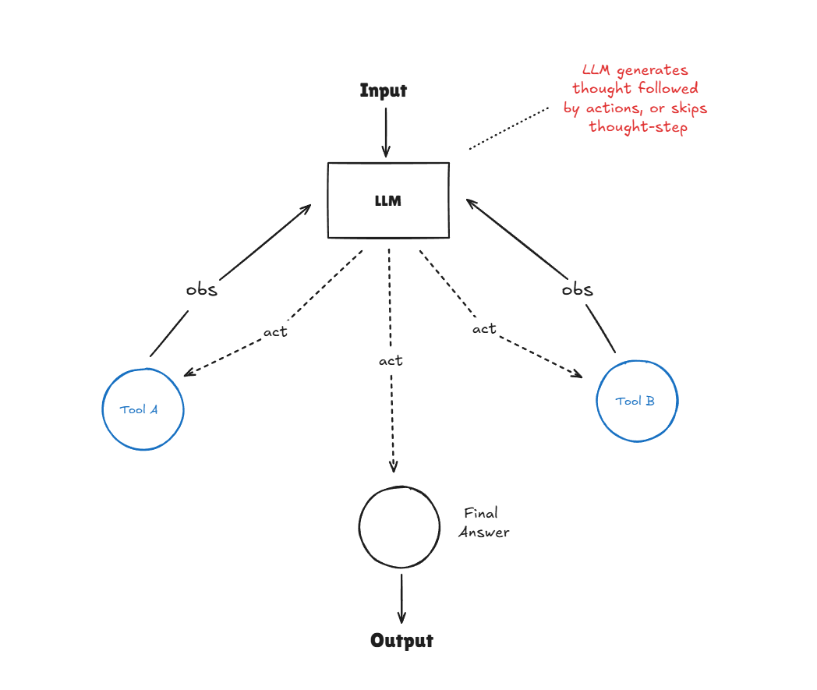
Pattern 1: Tool Use

Slide 8
Pattern 1: Tool Use (Build)
How to build it:
State: Use Annotated[list, add_messages] for your messages. It's designed to automatically handle AIMessage and ToolMessage objects.
Tool Node: Create a node to execute tools. It will parse tool_calls from the last message, run the functions, and return a list of ToolMessage objects.
Conditional Edge: Create a function that checks the tool_calls attribute of the last message.
<!-- end list -->
from langgraph.graph import StateGraph, END
from langgraph.graph.message import add_messages
from typing import TypedDict, Annotated
from langchain_core.messages import ToolMessage
# 1. State
class AgentState(TypedDict):
messages: Annotated[list, add_messages]
# 2. Tool Node
def tool_node(state: AgentState):
last_message = state['messages'][-1]
tool_call = last_message.tool_calls[0]
# ... logic to run the actual tool function ...
# result = my_search_tool(tool_call['args'])
result = "The weather is 70 degrees and sunny." # Mock result
return {"messages": [ToolMessage(content=str(result),
tool_call_id=tool_call['id'])]}

Slide 9
Pattern 1: Tool Use (Build)
# 3. Conditional Logic
def should_use_tools(state: AgentState):
last_message = state['messages'][-1]
if last_message.tool_calls:
return "tool_node" # Go to the tool-calling node
else:
return END # Stop the graph
# --- Graph Setup ---
workflow = StateGraph(AgentState)
workflow.add_node("model_node", model_function) # Your LLM-calling node
workflow.add_node("tool_node", tool_node)
workflow.set_entry_point("model_node")
# The conditional edge routes to tools or to the end
workflow.add_conditional_edges(
"model_node",
should_use_tools,
{
"tool_node": "tool_node",
END: END
}
)
# The tool node *always* loops back to the model
workflow.add_edge("tool_node", "model_node")
# app = workflow.compile()

Slide 10
Pattern 2: Reflection
Goal: Allow an agent to assess, critique, and improve its own output before returning it to the user.
This is a simple but powerful loop for increasing answer quality.
The Flow:
1. Generate Node: An LLM generates an initial answer to the user's request (e.g., writes a paragraph).
2. State Update: The draft answer is saved to the State.
3. Reflect Node: A second LLM call (or a rule-based function) acts as a "critic." It reads the
draft from the State and "grades" it (e.g., {"grade": "bad", "critique": "Too short."}).
4. State Update: The grade and critique are saved to the State.
5. Conditional Edge: A router function checks the grade.
○ If grade == "good", route to __end__.
○ If grade == "bad", route back to the Generate Node. The prompt for this node is
now updated to include the critique (e.g., "User wants X. Here is a bad draft: ...
Here is the critique: ... Please write a new, better draft.").

Slide 11
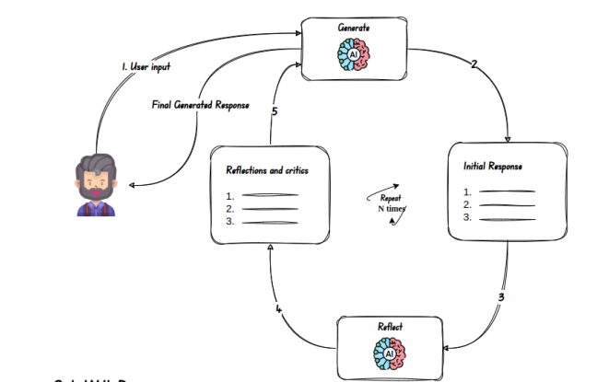
Pattern 2: Reflection

Slide 12
Pattern 2: Reflection (Build)
How to build it:
State: Add fields to your state to hold the critique and grade.
Tool Node: Create two distinct nodes: generate_node and reflect_node.
Conditional Edge: Create a function that routes based on the grade field.
<!-- end list -->
import random
from typing import TypedDict, Annotated
from langgraph.graph import StateGraph, END
from langgraph.graph.message import add_messages
# 1. State
class ReflectState(TypedDict):
messages: Annotated[list, add_messages]
grade: str # Our new field
# 2. Nodes
def generate_node(state: ReflectState):
print("---GENERATE NODE---")
# In a real app, you'd call an LLM
# If a critique exists, you'd add it to the prompt
response_text = f"I'm answering: {state['messages'][-1].content}"
return {"messages": [("ai", response_text)]}

Slide 13
Pattern 2: Reflection (Build)
def reflect_node(state: ReflectState):
print("---REFLECT NODE---")
# In a real app, you'd call an LLM as a "critic"
# Here, we'll just randomly "grade" the last AI message
grade = random.choice(["good", "bad"])
print(f"My grade is: {grade}")
return {"grade": grade}
# 3. Conditional Logic
def reflection_router(state: ReflectState):
print("---CHECKING GRADE---")
if state['grade'] == "good":
return END
else:
return "generate_node"
# Loop back to the 'generate' node
# --- Graph Setup ---
workflow = StateGraph(ReflectState)
workflow.add_node("generate_node", generate_node)
workflow.add_node("reflect_node", reflect_node)
workflow.set_entry_point("generate_node")
# After generating, always reflect
workflow.add_edge("generate_node", "reflect_node")
# After reflecting, use our conditional logic
workflow.add_conditional_edges(
"reflect_node",
reflection_router,
{
END: END,
"generate_node": "generate_node"
}
)
# app = workflow.compile()

Slide 14
Pattern 3: Planning
Goal: Guide an agent in a multi-step reasoning task by having it first create a "plan" and then
execute it.
This is for complex, ambiguous goals like "Research the market for new AI-powered headphones and write a summary."
The Flow:
1. Planner Node: The agent receives the user's goal. Its only job is to create a step-by-step plan (e.g., ["1. Search for competitors", "2. Find 3-5 product reviews", "3. Summarize key features", "4. Write final report"]).
2. State Update: The plan (a list) is saved to the State. We also add a past_steps list to track results.
3. Execute Node: This node reads the next step from the plan, executes it (often by calling a tool), and gets a result.
4. State Update: The (step, result) tuple is added to past_steps.
5. Replanner Node (Conditional): This is the "brain." An LLM looks at the original goal, the
remaining plan, and all past_steps. It then decides what to do next:
○ Continue: The plan is good. Route back to the Execute Node to run the next step.
○ Re-plan: The last step failed or something unexpected happened. Route back to
the Planner Node to create a new plan.
○ Finish: The plan is complete and the goal is met. Route to __end__.

Slide 15
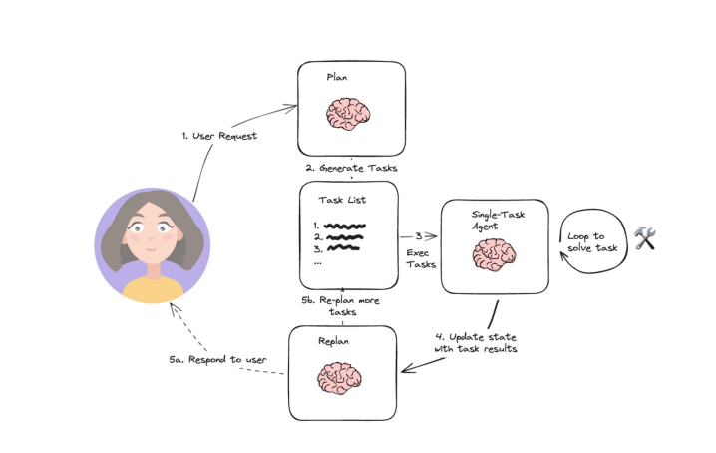
Pattern 3: Planning

Slide 16
Pattern 3: Planning(Build)
How to build it:
State: The State is crucial. It must track the plan, the results of past steps, and the original goal.
Tool Node: You'll have at least three: planner_node, execute_node, and replanner_node.
Conditional Edge: The edge after execute_node routes to the replanner_node. The replanner_node itself becomes a conditional router.
<!-- end list -->
from typing import List, Tuple
# 1. State
class PlanningState(TypedDict):
original_question: str
plan: List[str]
past_steps: List[Tuple[str, str]] # (step, result)
response: str # Final response
# 2. Nodes
def planner_node(state: PlanningState):
# Call LLM to create a plan based on 'original_question'
# new_plan = ...
# return {"plan": new_plan}
pass

Slide 17
Pattern 3: Planning (Build)
def execute_node(state: PlanningState):
# Get next step from state['plan']
# next_step = state['plan'][0]
# remaining_plan = state['plan'][1:]
# ... execute the step (often a tool call) ...
# result = ...
# new_past_steps = state['past_steps'] + [(next_step, result)]
# return {"plan": remaining_plan, "past_steps": new_past_steps}
pass
def replanner_node(state: PlanningState):
# Call LLM to decide what to do next
# if plan_is_complete:
# # ... generate final response …
# return {"response": final_response, "next_action": "finish"}
# elif needs_new_plan:
# return {"next_action": "replan"}
# else:
# return {"next_action": "continue"}
pass
# --- Graph Setup ---
workflow = StateGraph(PlanningState)
workflow.add_node("planner", planner_node)
workflow.add_node("execute_step", execute_node)
workflow.add_node("replanner", replanner_node)
workflow.set_entry_point("planner")
workflow.add_edge("planner", "execute_step")
workflow.add_edge("execute_step", "replanner")
# 3. Conditional Edge
workflow.add_conditional_edges(
"replanner",
lambda x: x["next_action"], # Get decision from state
{
"continue": "execute_step", # Loop to execute next step
"replan": "planner", # Go back to replan
"finish": END
}
)
# app = workflow.compile()

Slide 18
Pattern 4: Multi-Agent
Goal: Enable collaboration between multiple, specialized agents to solve a complex problem.
Think of a "team" of agents:
1. Researcher: Good at searching the web.
2. Writer: Good at composing long-form text.
3. Coordinator: A "manager" agent that routes tasks and messages between the other agents.
4. State Update: The (step, result) tuple is added to past_steps.
The Flow:
The user's request (e.g., "write a blog post about X") goes to the Coordinator.
The Coordinator decides the first step. "I need research." It routes the task to the Researcher agent.
The Researcher node (which could be its own nested LangGraph) runs and returns findings.
The findings go back to the Coordinator.
The Coordinator decides the next step. "Now I need a draft." It routes the findings to the Writer agent.
The Writer node runs and returns a draft.
The draft goes back to the Coordinator, which decides the task is complete and returns the final answer.

Slide 19
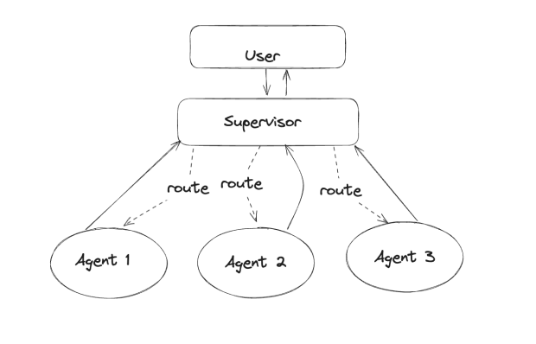
Pattern 4: Multi-Agent

Slide 20
Pattern 4: Multi-Agent(Build)
How to build it:
This pattern uses a central "router" to pass control between agents.
You can build separate graphs for each agent and "nest" them, or you can build one graph where each "node" represents a different agent.
Simple Example: Two-Agent Debate
State: messages (the full conversation) and turn (which agent speaks next).
Tool Node: agent_a_node and agent_b_node.
Conditional Edge: A "router" function checks the turn field and also checks for a "FINISH" keyword.
<!-- end list -->
# 1. State
class DebateState(TypedDict):
messages: Annotated[list, add_messages]
# 'turn' will be 'A' or 'B'
turn: str
# 3. Conditional Logic
def debate_router(state: DebateState):
# Simple stop condition
if len(state['messages']) > 6 or "FINISH" in
state['messages'][-1].content:
return END
# Route to the agent whose turn it is
return state['turn']

Slide 21
Pattern 4: Multi-Agent (Build)
# --- Graph Setup ---
workflow = StateGraph(DebateState)
workflow.add_node("A", agent_a_node)
workflow.add_node("B", agent_b_node)
# The router is the "Coordinator"
# We start the debate by routing to Agent A
workflow.set_entry_point("A")
# After Agent A speaks, route
workflow.add_conditional_edges(
"A",
debate_router,
{
"B": "B",
END: END
}
)
# After Agent B speaks, route
workflow.add_conditional_edges(
"B",
debate_router,
{
"A": "A",
END: END
}
)
# app = workflow.compile()
# app.invoke({"messages": [("user", "Start debating!")] , "turn": "A"})
# 2. Nodes
def agent_a_node(state: DebateState):
# ... call LLM for agent A ...
# new_message = ...
print("AGENT A: ...")
# Return the message and set the turn to 'B'
# return {"messages": [new_message], "turn": "B"}
pass
def agent_b_node(state: DebateState):
# ... call LLM for agent B ...
# new_message = ...
print("AGENT B: ...")
# Return the message and set the turn to 'A'
# return {"messages": [new_message], "turn": "A"}
pass

Slide 22
Q/A

Slide 23
Thanks

